Slide 1
Log analysis
Divakar

Slide 2
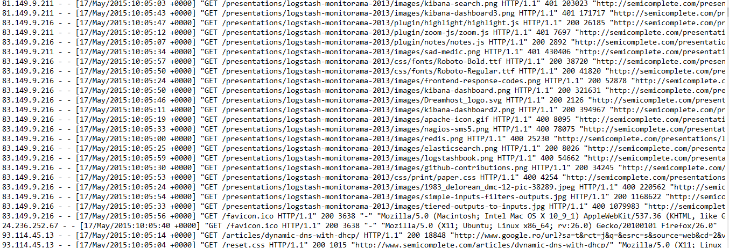
Data Mining
The sample network log is collected which has around 6973 lines

Slide 3
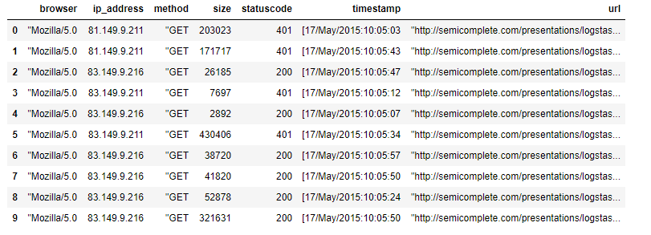
Data preprocessing and feature extraction
Using comma separated split to extract the log details from each line and put into table for further analysis.
Looking for duplicates
Filling missing values

Slide 4
Data preprocessing and feature extraction
The feature extracted from the log file,
IP Address
Date time
Status code
Http Method
Size
URL
Browser

Slide 5
Root cause Analysis
Need to get the report of status codes when issue is raised. The model will cluster the status codes into different groups.
Since we don’t have definite final output better to go with unsupervised machine learning techniques.
Chosen K means algorithm since it gives better performance with larger dataset.
The unique status codes present in dataset,

Slide 6
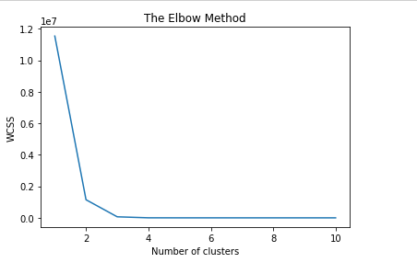
Root cause Analysis
Finding the unique centroids can be done in two ways in this case,
Based on elbow method
2. Unique status codes present in the data set

Slide 7
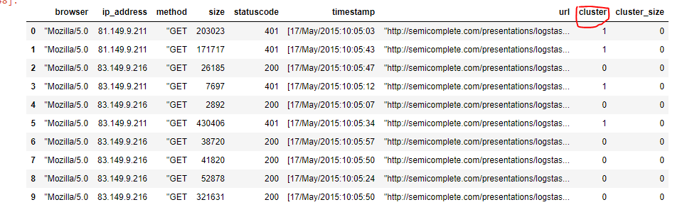
Root cause Analysis
When Kmeans algorithm is passed with preprocessed data we got 3 different clusters as below,

Slide 8
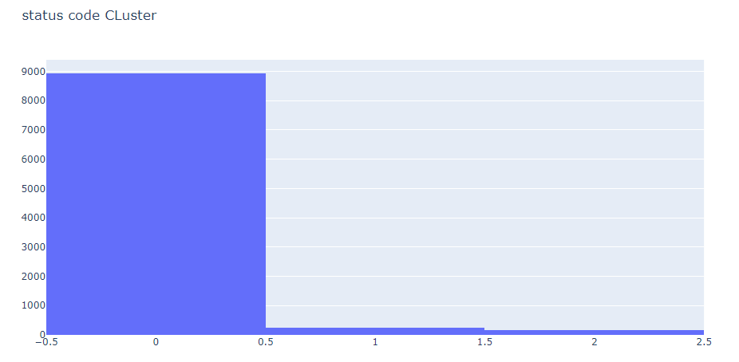
Root cause Analysis
From the output we can see that status codes 200 were in cluster 1
401(for example) status code was the next highest was in cluster 2. then we can conclude that users is having issue with authorization.

Slide 9
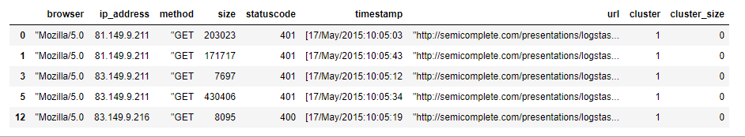
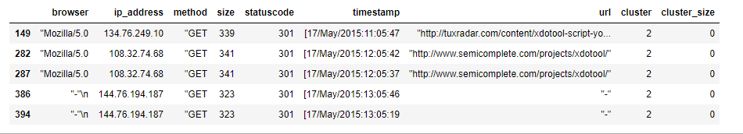
Root cause Analysis
Cluster 1 Top 5 rows
Cluster 2 top 5 rows

Slide 10
Root cause Analysis
Now need to trace the IP address, URL, size and timestamp of the failed cases and analyze more about what is wrong
Example : Cluster 3 is having status code number of 301. This implies resource moved. Devops team need to resolve this.

